Slide 1
The Intersection of AI and Ethics in the Workplace
Carolinas Air Pollution
Control Association
Presentation by:
Nathan Daniel, P.E.
Bunnell Lammons Engineering, Inc.

Slide 2

What is AI?
Mimics Human Cognitive Functions
Acquires Knowledge from Data
Reasoning
  Makes Decisions or Predictions Based on Data
Adaptability
  Improves Performance with Experience
Automation
  Executes tasks without constant human input
    Examples: Workflows, Agents, Webscraping, etc.

Slide 3
What are Large Language Models (LLMs)?

Slide 4
Benefits of AI in the Workplace
Productivity and Automation
Data Analysis and Decision Support
  Predictive analytics
Communication and Collaboration
  Transcription
  Language translation
  Knowledge retrieval (e.g., procedures, policy, data)
Strategy and Innovation

Slide 5
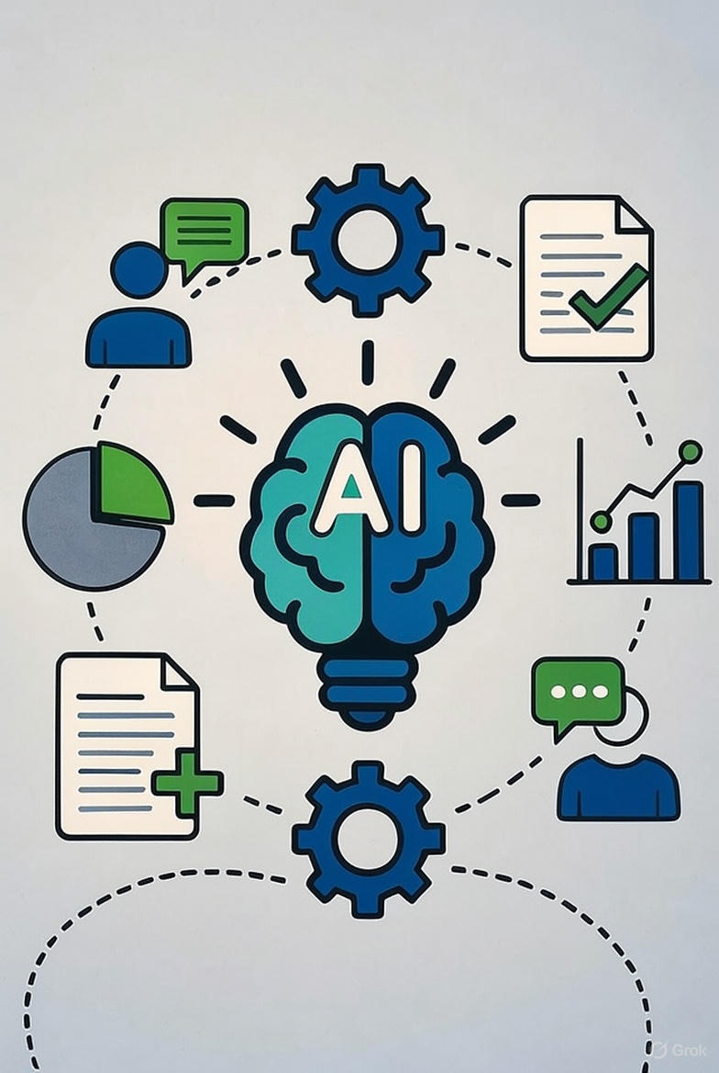
What are Workflows?
Structured process using AI to automate tasks
Typically integrate LLMs, Agents, or other tools
Follow programed steps to generate a desired output
Refine and train based on OT&E

Slide 6

Examples of Adopted Workflows
SOQ and Proposal Development
Data Entry Automation
Site Visit Record Generators
Plan Reviews and Agentic “Auditing”

Slide 7
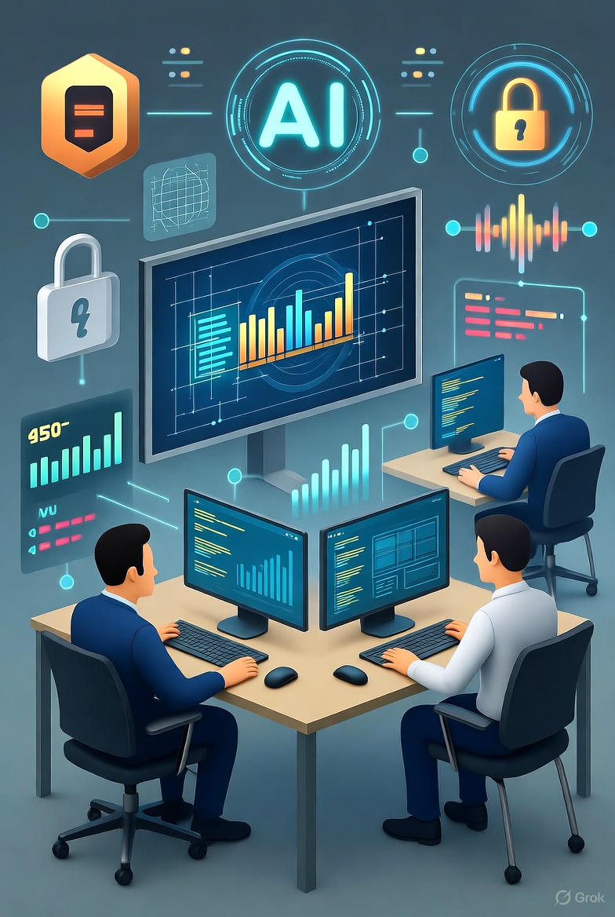
AI Concerns
Data Vulnerabilities
  Third Party Data
  NDAs
  Data Training
Over Reliance
  Error Rates
  MOC
Verification Challenges
  Hallucinations
  Lack of explainability
  “Black Box” approaches
  Senior reviews

Slide 9
Guidelines on the Use of Artificial Intelligence in Engineering and Surveying Services
North Carolina Board of Examiners for Engineers and Surveyors
www.ncbels.org
Presentation by:
David J. Evans, Assistant Executive Director

Slide 10
Use of Artificial Intelligence
Guidelines
Responsible Charge
Data Integrity and Control
Professional Competence
Oversight
Record Keeping
Takeaways

Slide 11
Use of AI Guidelines
AI may assist but does not replace professional judgment
Licensee must maintain responsible charge at all times
Oversight required for inputs, processes, and outputs
Work must be reproducible without AI

Slide 12
Responsible Charge
Licensee must:
  Be directly involved in work in progress and final product
  Retain authority to approve, reject, or change work
  Possess full professional knowledge of scope, data, and decisions
  Be able to answer questions about professional judgments made

Slide 13
Responsible Charge (Documentation)
Maintain detailed records:
  Calculations
  Drawings
  Data inputs and outputs
Document control to prove oversight and compliance
Accept full professional responsibility, regardless of AI use

Slide 14
Data Integrity and Control
Only use verified, accurate, and complete data
Licensee must maintain direct control over inputs
Validate AI outputs against professional standards
Ensure outputs can be understood, replicated, and reproduced

Slide 15
Professional Competence
Use AI only within areas of your demonstrated competence
AI cannot be used to expand a licensee's competence
Professional judgment remains mandatory
Stay current with AI technology, capabilities, and limitations

Slide 16
Ongoing Oversight
Regularly review AI-assisted work
Update processes to maintain quality and compliance
Ensure no compromise of public health, safety, and welfare

Slide 17
Record Keeping
Maintain:
  Data inputs
  Processing methods
  Tool assessments
  Validation procedures
Records must support claim of responsible charge

Slide 18
Takeaways
Licensee – not AI – remains fully responsible
AI may enhance work, but never reduce accountability
Oversight, verification, and documentation are essential
Compliance with Board Rules is non-negotiable

Slide 19
Artificial Intelligence – Key Takaway
"By adhering to these guidelines, licensees ensure that AI use strengthens – not undermines – the professional responsibility, integrity, and public trust required in engineering and surveying practice."

Slide 20
Takeaways
National Council of Examiners for Engineering and Surveying (NCEES) has also adopted a Position Statement on use of AI
AI has been used to create fraudulent documents
  Seal security will be key to combat it
  At some point, will engineers and surveyors need to only use electronic certification that is authenticated?

Slide 22
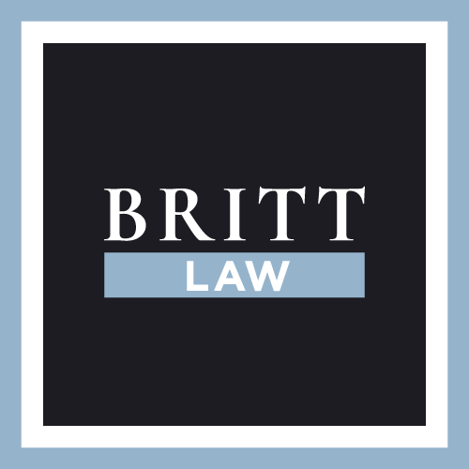

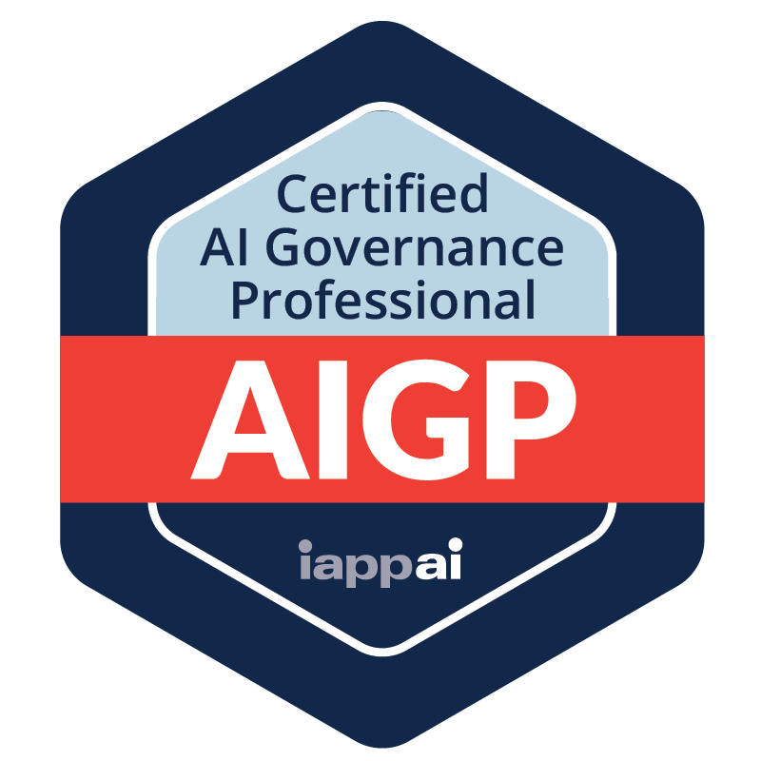


AI LAWS & REGS
Carolinas Air Pollution
Control Association
Steve Britt, Britt Law LLC

Slide 23
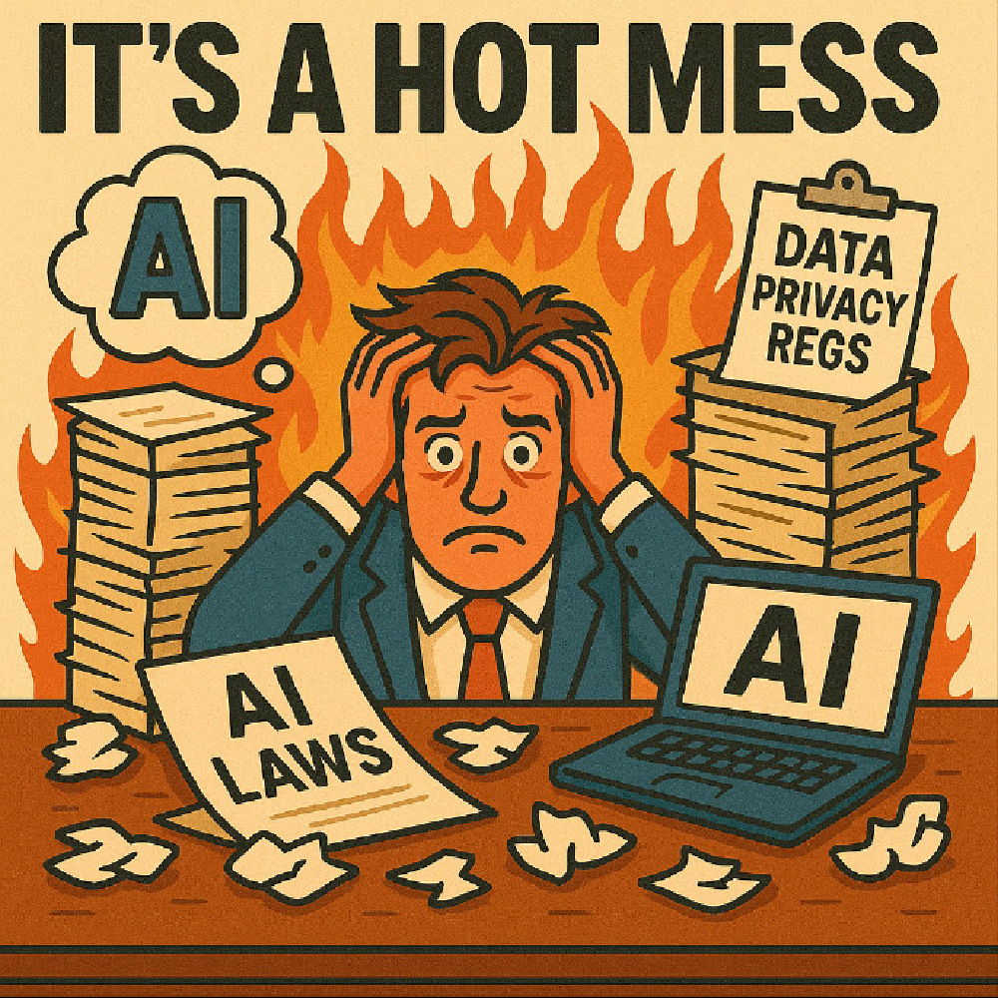
AI Laws & Regs

Slide 24
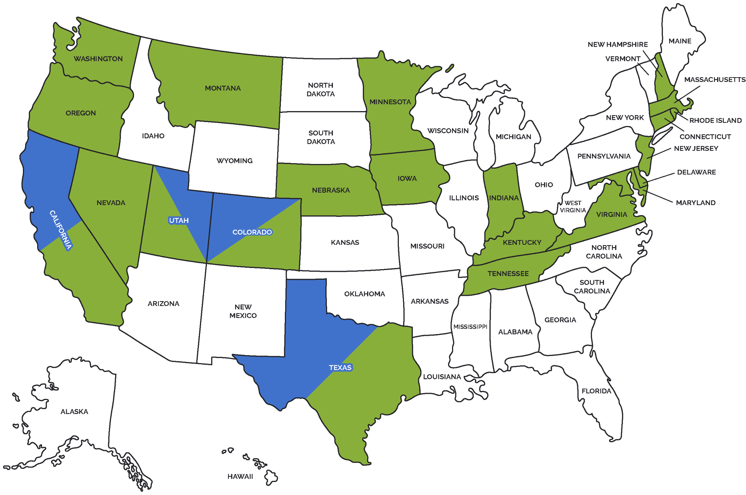
US Legal Landscape

Slide 25
NIST RESPONSIBLE AI STANDARDS
            Valid & Reliable
            Accurate & Robust
            Safe
            Secure & Resilient
            Accountable & Transparent
            Explainable & Interpretable
            Privacy-Enhanced
            Fair w/ Harmful Bias Managed

Slide 26
CATEGORIES OF HIGH-RISK AI DECISIONS
            Education
            Employment
            Health care
            Financial services
            Public benefits
            Housing
            Insurance
            Justice or democracy
            Right to solitude

Slide 27
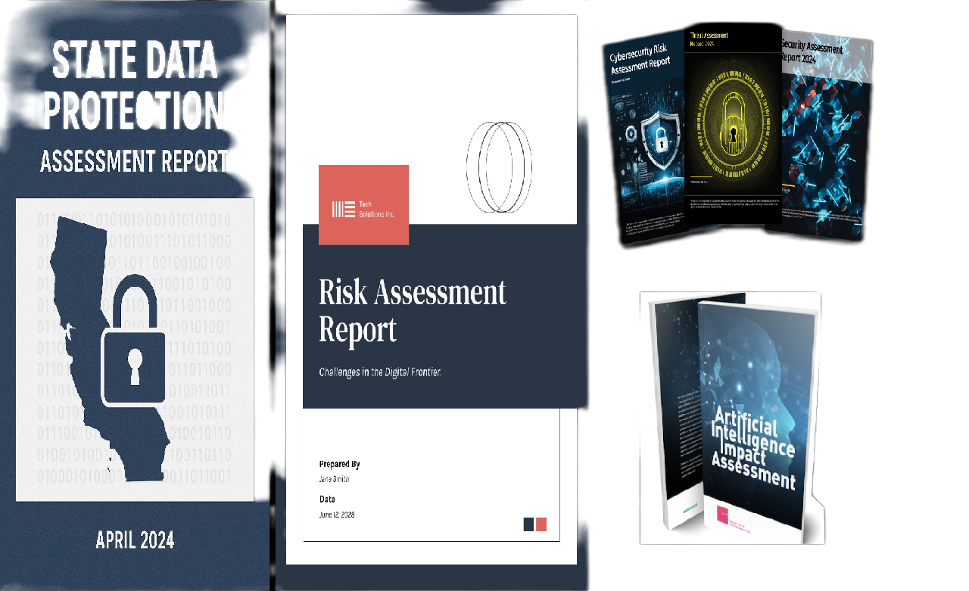
Data Management Compliance
State Data Protection Assessments
AI Risk Assessments
EU Compliance Assessments
CA Cyber/Risk Assessments & ADMT

Slide 28
Cyber / Risk Assessments & ADMT
Processing that poses a significant risk:
CYBER AUDIT
Annual Audits
Certificate of Compliance to CPPA
RISK ASSESSMENTS
All operations, risks, impacts & safeguards
Assessment reports to CPPA
ADMT
Right of Access to ADMT
Right to Opt-Out of ADMT
Right to Appeal ADMT to human reviewer

Slide 29
AI Game Plan
Structure Data Governance
Prepare data privacy & AI risk assessments
Implement trustworthy standards
Determine consequential decisions
Establish guardrails re harmful or infringing output
Honor all data subject rights
Manage tracking technology risks

Slide 30
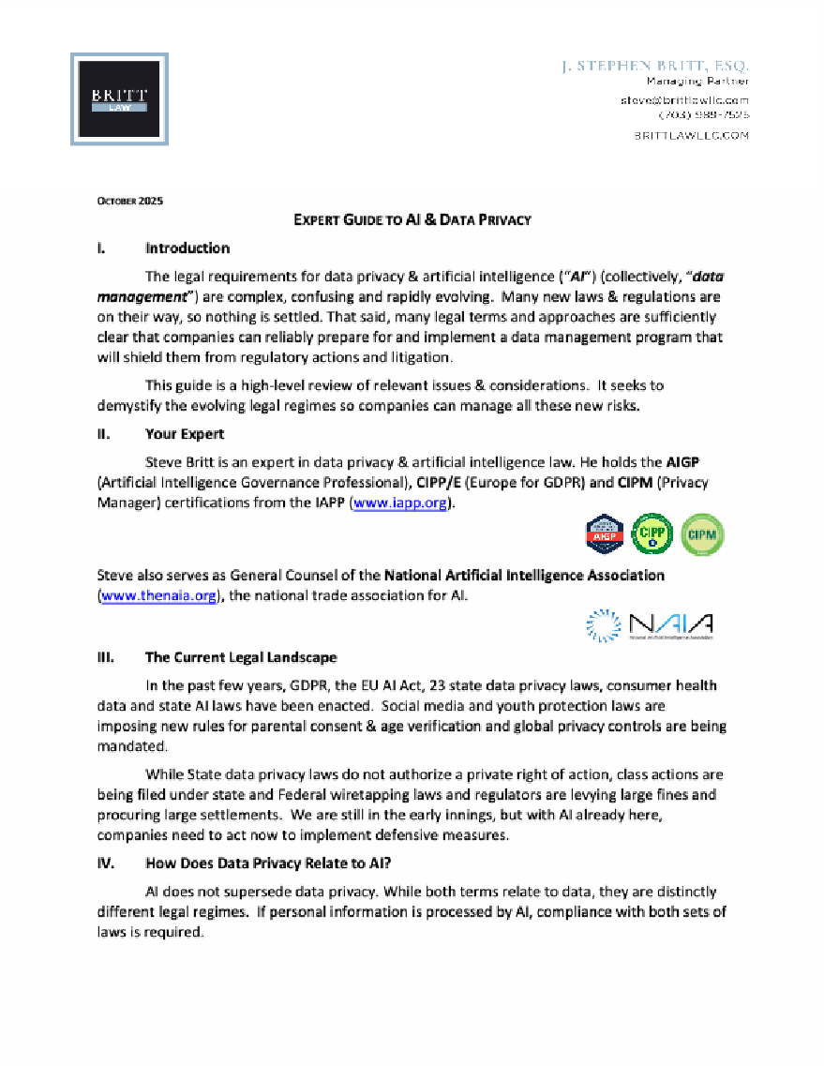
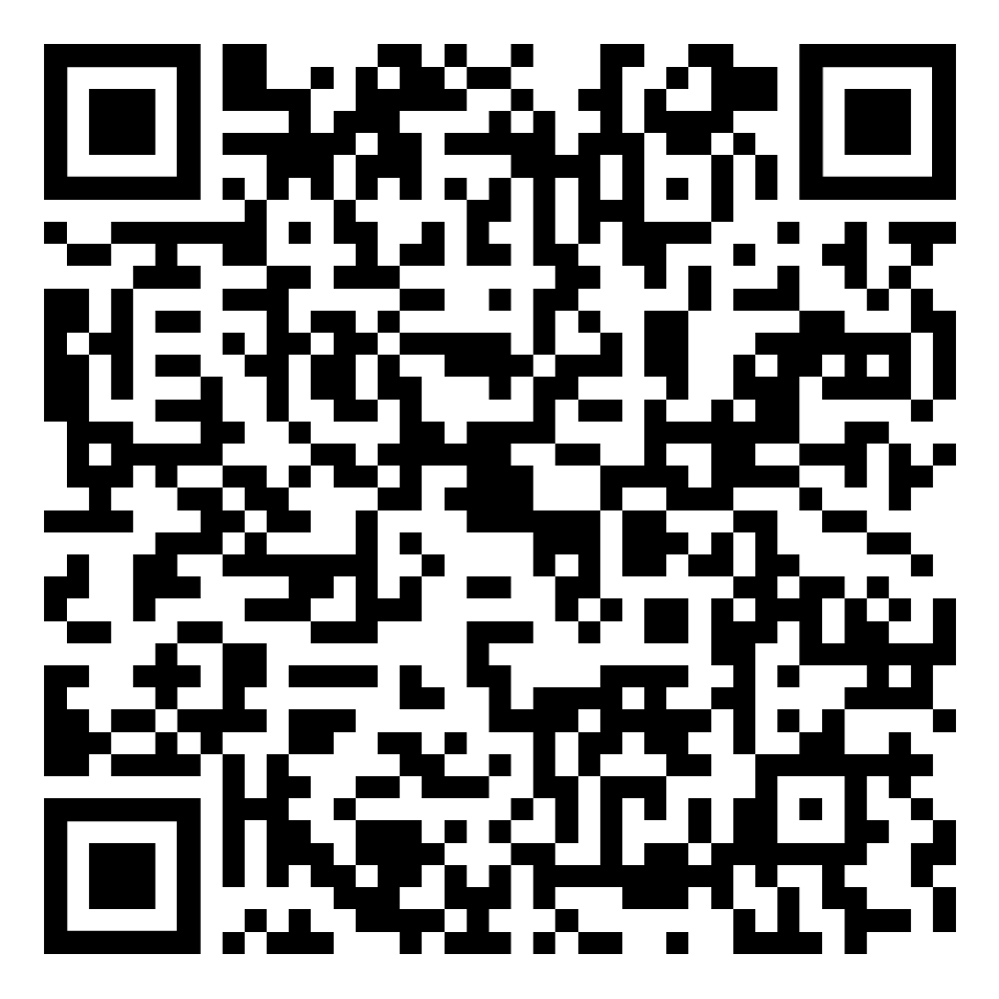
Expert Guide to AI & Data Privacy
Scan the QR code for
the Expert Guide to AI & Data Privacy

Slide 31
